Slide 1
My journal to python
4110E211 尤拉梅
MY DEAR GREAT TEACHER

Slide 2
AGENDA
Python
Input and Output : input() and print
Data Types : numeric, string, list, dict.
Operation ON data type:
CONTROLS : IF- | IF –ELSE IF | -F-ELSE
LOOP : FOR |WHILE | RANGE () |BREAK | CONTINUE
FUNCTION
PARAMETERS (ARGUMENTS)
RECURSIVE FUNCTION
LAMBA FUNCTION

Slide 3
What is Python?
Python is a popular programming language. It was created by Guido van Rossum, and released in 1991.
It is used for:
web development (server-side),
software development,
mathematics,
system scripting.
What can Python do?
Python can be used on a server to create web applications.
Python can be used alongside software to create workflows.
Python can connect to database systems. It can also read and modify files.
Python can be used to handle big data and perform complex mathematics.
Python can be used for rapid prototyping, or for production-ready software development.
Why Python?
Python works on different platforms (Windows, Mac, Linux, Raspberry Pi, etc).
Python has a simple syntax similar to the English language.
Python has syntax that allows developers to write programs with fewer lines than some other programming languages.
Python runs on an interpreter system, meaning that code can be executed as soon as it is written. This means that prototyping can be very quick.
Python can be treated in a procedural way, an object-oriented way or a functional way

Slide 4
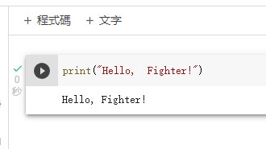
Good to know:
The most recent major version of Python is Python 3, which we shall be using in this tutorial.
However, Python 2, although not being updated with anything other than security updates, is still quite popular.
In this tutorial Python will be written in a text editor.
It is possible to write Python in an Integrated Development Environment, such as Thonny, Pycharm, Netbeans or Eclipse which are particularly useful when managing larger collections of Python files.
Example

Slide 5
PYTHON SYNTAX

Slide 6
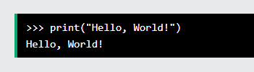

Python syntax can be executed by writing directly in the Command Line:
Or by creating a python file on the server, using the .py file extension, and running it in the Command Line:

Slide 7
Python Indentation
Indentation refers to the spaces at the beginning of a code line.
Where in other programming languages the indentation in code is for readability only, the indentation in Python is very important.
Python uses indentation to indicate a block of code.

Slide 8
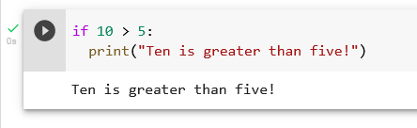
Python uses indentation to indicate a block of code.
Example

Slide 9
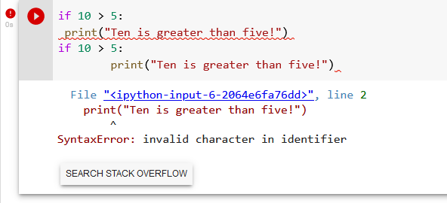
Python will give you an error if you skip the indentation:
Example

Slide 10
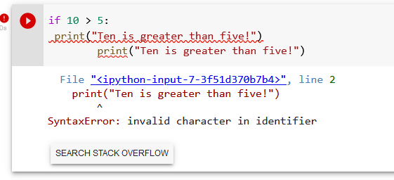
Example

Slide 11
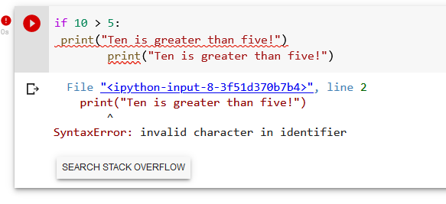
You have to use the same number of spaces in the same block of code, otherwise Python will give you an error:

Slide 12
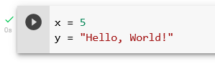
In Python, variables are created when you assign a value to it:
Example

Slide 13
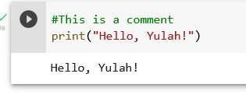
Python has no command for declaring a variable. Comments
Python has commenting capability for the purpose of in-code documentation.
Comments start with a #, and Python will render the rest of the line as a comment:
Example

Slide 14
Python Variables
In Python, variables are created when you assign a value to it:

Slide 15
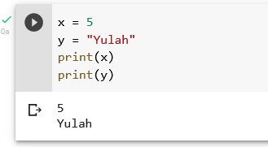
Example
Variables in Python:
Python has no command for declaring a variable.
You will learn more about variables in the Python Variables chapter.

Slide 16
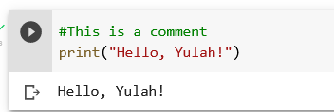
Comments
Python has commenting capability for the purpose of in-code documentation.
Comments start with a #, and Python will render the rest of the line as a comment:
Example

Slide 17
Comments can be used to explain Python code. Comments can be used to make the code more readable. Comments can be used to prevent execution when testing code.
Creating a Comment
Comments starts with a #, and Python will ignore them:

Slide 18
Python Comments

Slide 19
Comments can be used to explain Python code.
Comments can be used to make the code more readable.
Comments can be used to prevent execution when testing code.
Creating a Comment
Comments starts with a #, and Python will ignore them:

Slide 20
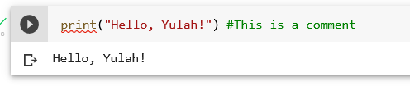
Comments can be placed at the end of a line, and Python will ignore the rest of the line:
Example

Slide 21
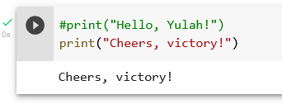
A comment does not have to be text that explains the code, it can also be used to prevent Python from executing code:

Slide 22
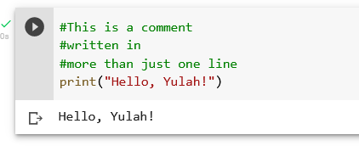
Multi Line Comments
Python does not really have a syntax for multi line comments.
To add a multiline comment you could insert a # for each line:
Example

Slide 23
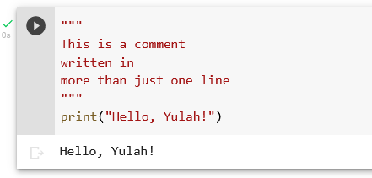
Or, not quite as intended, you can use a multiline string.
Since Python will ignore string literals that are not assigned to a variable, you can add a multiline string (triple quotes) in your code, and place your comment inside it:
Example
As long as the string is not assigned to a variable, Python will read the code, but then ignore it, and you have made a multiline comment.

Slide 24
Python Variables
Variables
Variables are containers for storing data values.

Slide 25
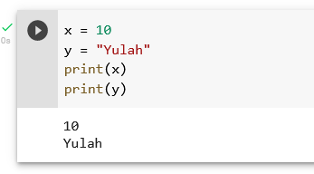
Creating Variables
Python has no command for declaring a variable.
A variable is created the moment you first assign a value to it.
Example

Slide 26
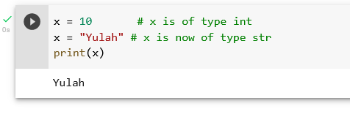
Variables do not need to be declared with any particular type, and can even change type after they have been set.
Example

Slide 27
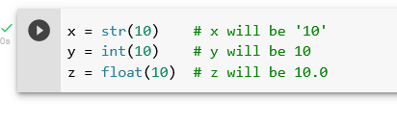
Casting
If you want to specify the data type of a variable, this can be done with casting.
Example

Slide 28
Python - Variable Names
Variable Names
A variable can have a short name (like x and y) or a more descriptive name (age, carname, total_volume). Rules for Python variables: A variable name must start with a letter or the underscore character
A variable name cannot start with a number
A variable name can only contain alpha-numeric characters and underscores (A-z, 0-9, and _ )
Variable names are case-sensitive (age, Age and AGE are three different variables)

Slide 29
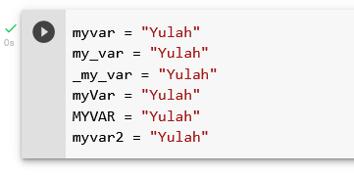
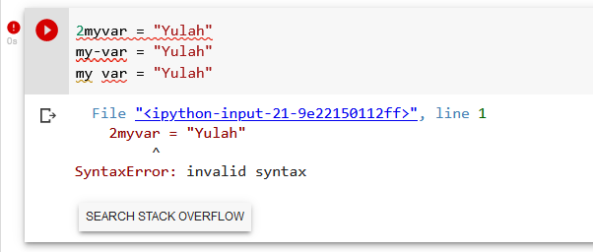
Example
Example
Illegal variable names:

Slide 30

Multi Words Variable Names
Variable names with more than one word can be difficult to read.
There are several techniques you can use to make them more readable:
Camel Case
Each word, except the first, starts with a capital letter:
Each word starts with a capital letter:

Slide 31


Pascal Case
Each word starts with a capital letter:
Snake Case
Each word is separated by an underscore character:

Slide 32
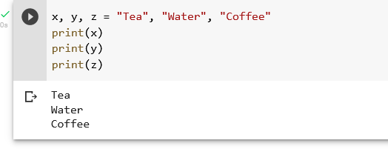
Python Variables - Assign Multiple Values
Many Values to Multiple Variables
Python allows you to assign values to multiple variables in one line:
Example

Slide 33
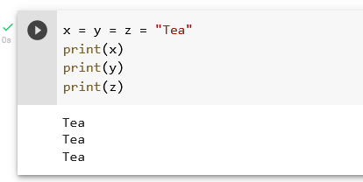
One Value to Multiple Variables
And you can assign the same value to multiple variables in one line:
Example

Slide 34
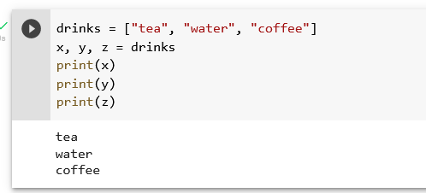
Unpack a Collection
If you have a collection of values in a list, tuple etc. Python allows you to extract the values into variables. This is called unpacking.
Example

Slide 35
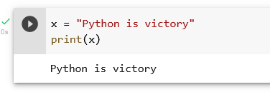
Python - Output Variables
Output Variables
The Python print() function is often used to output variables.
Example

Slide 36
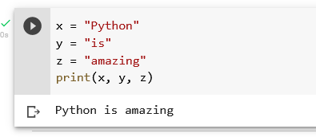
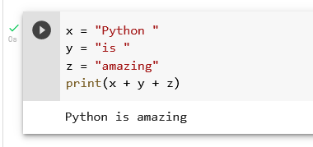
In the print() function, you output multiple variables, separated by a comma:
Example
You can also use the + operator to output multiple variables:
Example

Slide 37
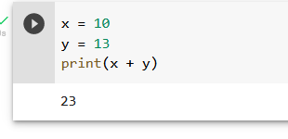
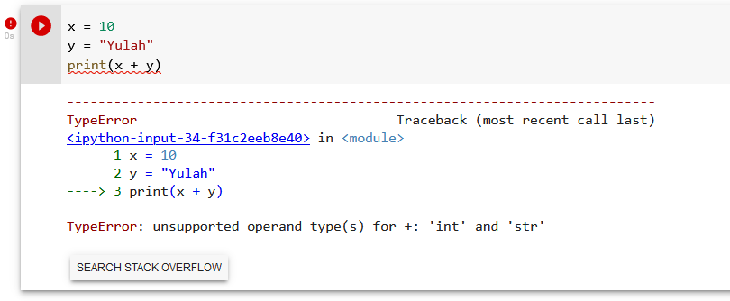
For numbers, the + character works as a mathematical operator:
Example
In the print() function, when you try to combine a string and a number with the + operator, Python will give you an error:
Example

Slide 38
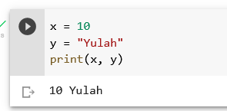
The best way to output multiple variables in the print() function is to separate them with commas, which even support different data types:
Example

Slide 39
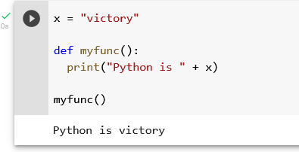
Python - Global Variables
Global Variables
Variables that are created outside of a function (as in all of the examples above) are known as global variables. Global variables can be used by everyone, both inside of functions and outside.
Example

Slide 40
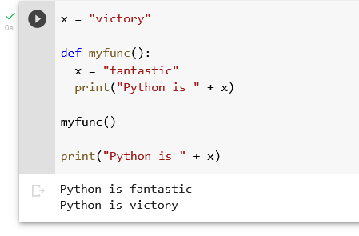
If you create a variable with the same name inside a function, this variable will be local, and can only be used inside the function. The global variable with the same name will remain as it was, global and with the original value.
Example
Create a variable inside a function, with the same name as the global variable

Slide 41
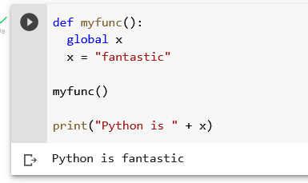
The global Keyword
Normally, when you create a variable inside a function, that variable is local, and can only be used inside that function. To create a global variable inside a function, you can use the global keyword.
Example
If you use the global keyword, the variable belongs to the global scope:

Slide 42
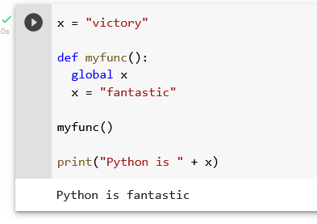
Also, use the global keyword if you want to change a global variable inside a function.
Example
To change the value of a global variable inside a function, refer to the variable by using the global keyword:

Slide 43
Python Data Types

Slide 44
Built-in Data Types
In programming, data type is an important concept.
Variables can store data of different types, and different types can do different things.

Slide 45
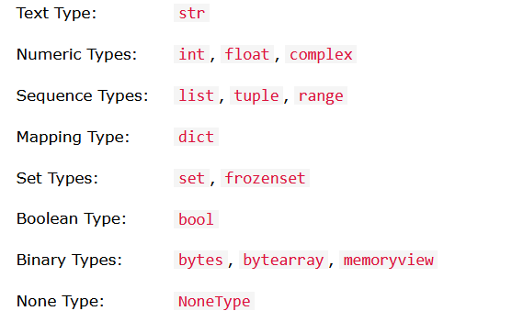
Python has the following data types built-in by default, in these categories:

Slide 46
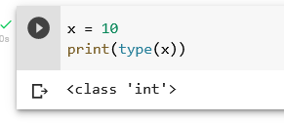
Getting the Data Type
You can get the data type of any object by using the type() function:
Example
Print the data type of the variable x:

Slide 47
Setting the Data Type

Slide 48
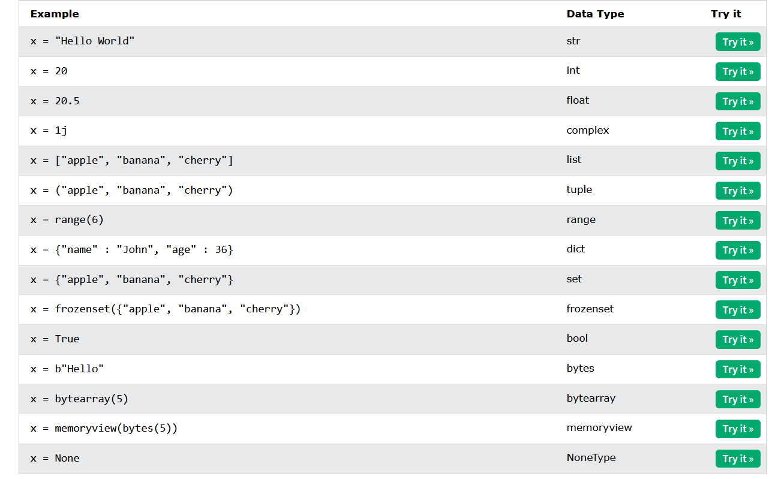
In Python, the data type is set when you assign a value to a variable:

Slide 49
Setting the Specific Data Type

Slide 50
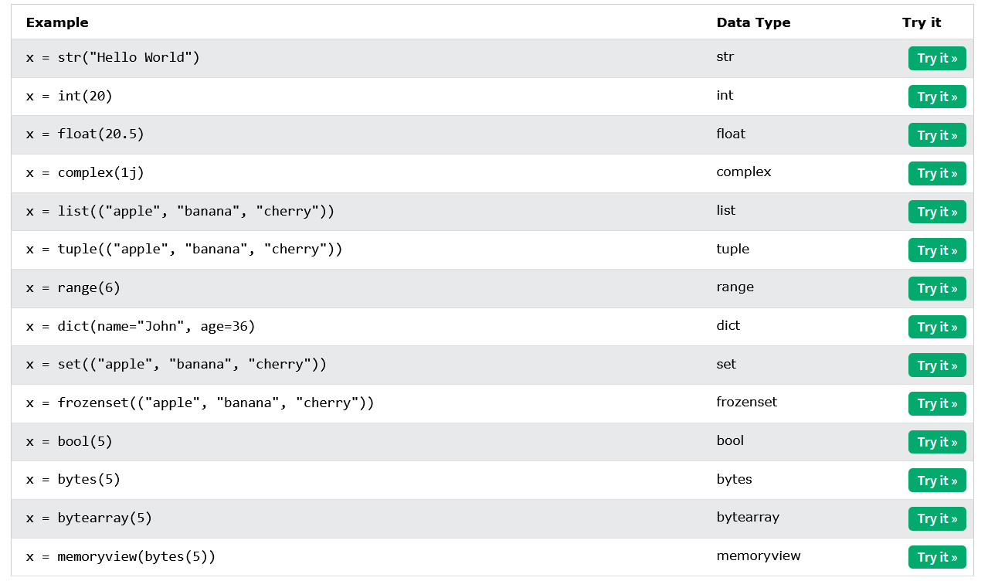
If you want to specify the data type, you can use the following constructor functions:

Slide 51
Python Numbers

Slide 52
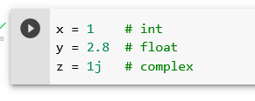
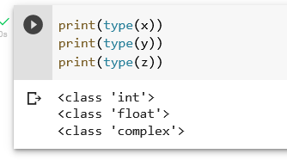
There are three numeric types in Python: int float complex Variables of numeric types are created when you assign a value to them:
Example
To verify the type of any object in Python, use the type() function:

Slide 53
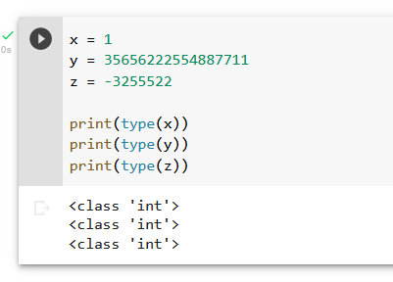
Int
Int, or integer, is a whole number, positive or negative, without decimals, of unlimited length.
Example
Integers

Slide 54
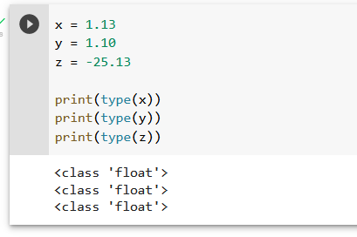
Float
Float, or "floating point number" is a number, positive or negative, containing one or more decimals.
Example

Slide 55
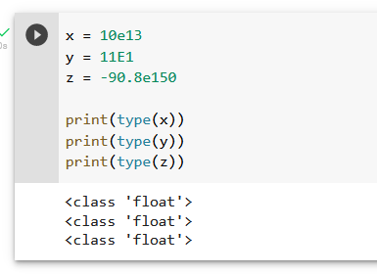
Float can also be scientific numbers with an "e" to indicate the power of 10.
Example
Floats:

Slide 56
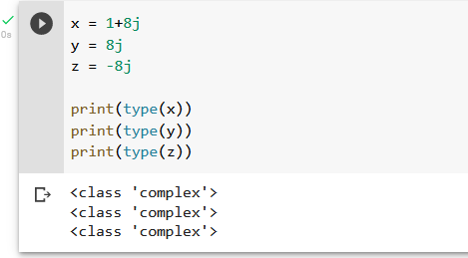
Complex
Complex numbers are written with a "j" as the imaginary part:
Example
Complex:

Slide 57
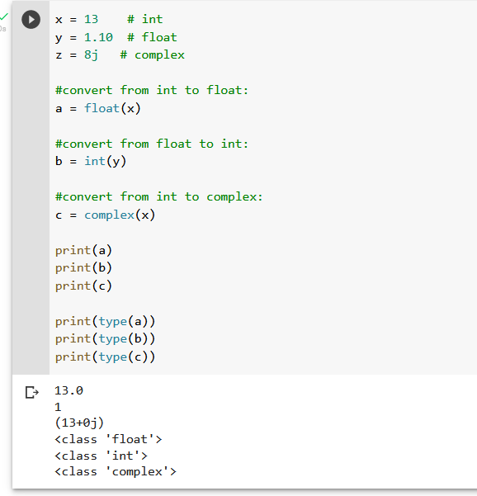
Type Conversion
You can convert from one type to another with the int(), float(), and complex() methods:
Example
Convert from one type to another:

Slide 58
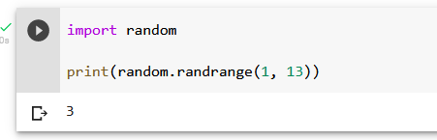
Random Number
Python does not have a random() function to make a random number, but Python has a built-in module called random that can be used to make random numbers:
Example
Import the random module, and display a random number between 1 and 9:

Slide 59
Python Casting

Slide 60
Specify a Variable Type

Slide 61
There may be times when you want to specify a type on to a variable. This can be done with casting. Python is an object-orientated language, and as such it uses classes to define data types, including its primitive types.
Casting in python is therefore done using constructor functions:
int() - constructs an integer number from an integer literal, a float literal (by removing all decimals), or a string literal (providing the string represents a whole number)
float() - constructs a float number from an integer literal, a float literal or a string literal (providing the string represents a float or an integer)
str() - constructs a string from a wide variety of data types, including strings, integer literals and float literals

Slide 62

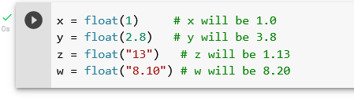
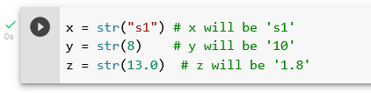
Example
Integers:
Floats:
Strings:

Slide 63
Python Strings

Slide 64
Strings
Strings in python are surrounded by either single quotation marks, or double quotation marks.
'hello' is the same as "hello".

Slide 65
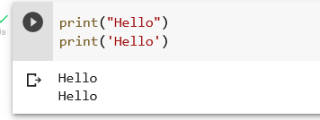
You can display a string literal with the print() function:
Example

Slide 66
Assign String to a Variable

Slide 67
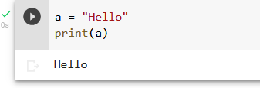
Assigning a string to a variable is done with the variable name followed by an equal sign and the string:
Example

Slide 68
Multiline Strings

Slide 69
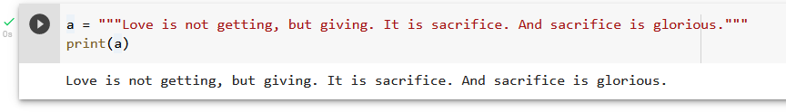
You can assign a multiline string to a variable by using three quotes:
Example
You can use three double quotes:

Slide 70
Or three single quotes:
Example

Slide 71
Strings are Arrays

Slide 72
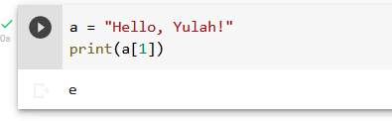
Like many other popular programming languages, strings in Python are arrays of bytes representing unicode characters.
However, Python does not have a character data type, a single character is simply a string with a length of 1.
Square brackets can be used to access elements of the string.
Example
Get the character at position 1 (remember that the first character has the position 0):

Slide 73
Looping Through a String

Slide 74

Since strings are arrays, we can loop through the characters in a string, with a for loop.
Example
Loop through the letters in the word “square":

Slide 75
String Length

Slide 76

To get the length of a string, use the len() function.
Example
The len() function returns the length of a string:

Slide 77
Check String
To check if a certain phrase or character is present in a string, we can use the keyword in.

Slide 78

Example
Check if “sacrifice" is present in the following text

Slide 79

Use it in an if statement:
Example
Print only if “sacrifice" is present:

Slide 80
Check if NOT
To check if a certain phrase or character is NOT present in a string, we can not in.

Slide 81

Example
Check if “Family" is NOT present in the following text:

Slide 82

Use it in an if statement:
Example
print only if “friendship" is NOT present:

Slide 83
Python - Slicing Strings

Slide 84

Example
Get the characters from position 2 to position 5 (not included):

Slide 85
Slicing
You can return a range of characters by using the slice syntax.
Specify the start index and the end index, separated by a colon, to return a part of the string.

Slide 86
Slice From the Start
By leaving out the start index, the range will start at the first character:

Slide 87

Example
Get the characters from the start to position 5 (not included):

Slide 88
Slice To the End
By leaving out the end index, the range will go to the end:

Slide 89

Example
Get the characters from position 2, and all the way to the end:

Slide 90
Negative Indexing
Use negative indexes to start the slice from the end of the string:

Slide 91

Example
Get the characters:
From: “l" in “Yulah!" (position -5)
To, but not included: “h" in “Yulah!" (position -2)

Slide 92
Python - Modify Strings
Python has a set of built-in methods that you can use on strings.

Slide 93
Upper Case

Slide 94

Example
The upper() method returns the string in upper case:

Slide 95
Lower Case

Slide 96

Example
The lower() method returns the string in lower case:

Slide 97
Remove Whitespace
Whitespace is the space before and/or after the actual text, and very often you want to remove this space.

Slide 98

Example
The strip() method removes any whitespace from the beginning or the end:

Slide 99
Replace String

Slide 100

Example
The replace() method replaces a string with another string:

Slide 101
Split String
The split() method returns a list where the text between the specified separator becomes the list items.

Slide 102

Example
The split() method splits the string into substrings if it finds instances of the separator:

Slide 103
Python - String Concatenation
String Concatenation
To concatenate, or combine, two strings you can use the + operator.

Slide 104

Example
Merge variable a with variable b into variable c:

Slide 105

Example
To add a space between them, add a " ":

Slide 106
Python - Format - Strings

Slide 107
String Format

Slide 108

As we learned in the Python Variables chapter, we cannot combine strings and numbers like this:
Example

Slide 109

Example
Use the format() method to insert numbers into strings:

Slide 110

The format() method takes unlimited number of arguments, and are placed into the respective placeholders:
Example

Slide 111

You can use index numbers {0} to be sure the arguments are placed in the correct placeholders:
Example

Slide 112
Python - Escape Characters

Slide 113
Escape Character
To insert characters that are illegal in a string, use an escape character.
An escape character is a backslash \ followed by the character you want to insert.

Slide 114

An example of an illegal character is a double quote inside a string that is surrounded by double quotes:
Example You will get an error if you use double quotes inside a string that is surrounded by double quotes:

Slide 115

Example
The escape character allows you to use double quotes when you normally would not be allowed:

Slide 116

Escape Characters
Other escape characters used in Python:

Slide 117
Python - String Methods

Slide 118


String Methods
Python has a set of built-in methods that you can use on strings.

Slide 121
Python Booleans

Slide 122
Boolean Values
In programming you often need to know if an expression is True or False.
You can evaluate any expression in Python, and get one of two answers, True or False

Slide 123

When you compare two values, the expression is evaluated and Python returns the Boolean answer:
Example

Slide 124

When you run a condition in an if statement, Python returns True or False:
Example
Print a message based on whether the condition is True or False:

Slide 125
Evaluate Values and Variables
The bool() function allows you to evaluate any value, and give you True or False in return,

Slide 126


Example
Evaluate a string and a number:
Example
Evaluate two variables:

Slide 127
Most Values are True

Slide 128

Almost any value is evaluated to True if it has some sort of content.
Any string is True, except empty strings.
Any number is True, except 0.
Any list, tuple, set, and dictionary are True, except empty ones.
Example
The following will return True:

Slide 129
Some Values are False

Slide 130

In fact, there are not many values that evaluate to False, except empty values, such as (), [], {}, "", the number 0, and the value None. And of course the value False evaluates to False.
Example
The following will return False:

Slide 131

One more value, or object in this case, evaluates to False, and that is if you have an object that is made from a class with a __len__ function that returns 0 or False:
Example

Slide 132
Functions can Return a Boolean

Slide 133

You can create functions that returns a Boolean Value:
Example
Print the answer of a function:

Slide 134

You can execute code based on the Boolean answer of a function:
Example
Print "YES!" if the function returns True, otherwise print "NO!":

Slide 135

Python also has many built-in functions that return a boolean value, like the isinstance() function, which can be used to determine if an object is of a certain data type:
Example
Check if an object is an integer or not:

Slide 136
Python Operators

Slide 137

Operators are used to perform operations on variables and values. In the example below, we use the + operator to add together two values:
Example
Python divides the operators in the following groups:
Arithmetic operators
Assignment operators
Comparison operators
Logical operators
Identity operators
Membership operators
Bitwise operators

Slide 138

Python Arithmetic Operators
Arithmetic operators are used with numeric values to perform common mathematical operations:

Slide 139

Python Assignment Operators
Assignment operators are used to assign values to variables:

Slide 140

Python Comparison Operators
Comparison operators are used to compare two values:

Slide 141


Python Logical Operators
Logical operators are used to combine conditional statements:
Python Identity Operators
Identity operators are used to compare the objects, not if they are equal, but if they are actually the same object, with the same memory location:

Slide 142


Python Membership Operators
Membership operators are used to test if a sequence is presented in an object:
Python Bitwise Operators
Bitwise operators are used to compare (binary) numbers:

Slide 143

Python Lists
List
Lists are used to store multiple items in a single variable.
Lists are one of 4 built-in data types in Python used to store collections of data, the other 3 are Tuple, Set, and Dictionary, all with different qualities and usage.
Lists are created using square brackets:

Slide 144

Example
Create a List:
List Items
List items are ordered, changeable, and allow duplicate values.
List items are indexed, the first item has index [0], the second item has index [1] etc.

Slide 145

Ordered
When we say that lists are ordered, it means that the items have a defined order, and that order will not change.
If you add new items to a list, the new items will be placed at the end of the list.
Changeable
The list is changeable, meaning that we can change, add, and remove items in a list after it has been created.
Allow Duplicates
Since lists are indexed, lists can have items with the same value:
Example
Lists allow duplicate values:

Slide 146

List Length
To determine how many items a list has, use the len() function:
Example
Print the number of items in the list:

Slide 147

List Items - Data Types List items can be of any data type:
Example
String, int and boolean data types:

Slide 148


A list can contain different data types:
Example
A list with strings, integers and boolean values:
type()
From Python's perspective, lists are defined as objects with the data type 'list':

Slide 149


Example What is the data type of a list?
The list() Constructor
It is also possible to use the list() constructor when creating a new list.
Example
Using the list() constructor to make a List:

Slide 150

Python - Access List Items
Access Items
List items are indexed and you can access them by referring to the index number:
Example
Print the second item of the list:

Slide 151


Negative Indexing
Negative indexing means start from the end
-1 refers to the last item, -2 refers to the second last item etc.
Example
Print the last item of the list:
Range of Indexes
You can specify a range of indexes by specifying where to start and where to end the range.
When specifying a range, the return value will be a new list with the specified items.
Example
Return the third, fourth, and fifth item:

Slide 152


By leaving out the start value, the range will start at the first item:
Example
This example returns the items from the beginning to, but NOT including, "kiwi":
By leaving out the end value, the range will go on to the end of the list:
Example
This example returns the items from "cherry" to the end:

Slide 153


Range of Negative Indexes Specify negative indexes if you want to start the search from the end of the list:
Example
This example returns the items from "orange" (-4) to, but NOT including "mango" (-1):
Check if Item Exists
To determine if a specified item is present in a list use the in keyword:
Example
Check if "apple" is present in the list:

Slide 154


Python - Change List Items
Change Item Value
To change the value of a specific item, refer to the index number:
Example
Change the second item:
Change a Range of Item Values
To change the value of items within a specific range, define a list with the new values, and refer to the range of index numbers where you want to insert the new values:
Example
Change the values “tea" and “coffee" with the values "blackcurrant" and “wine":

Slide 155


If you insert more items than you replace, the new items will be inserted where you specified, and the remaining items will move accordingly:
Example
Change the second value by replacing it with two new values:
Insert Items
To insert a new list item, without replacing any of the existing values, we can use the insert() method.
The insert() method inserts an item at the specified index:
Example
Insert “wine" as the third item:

Slide 156


Python - Add List Items
Append Items
To add an item to the end of the list, use the append() method:
Example
Using the append() method to append an item:
Insert Items
To insert a list item at a specified index, use the insert() method.
The insert() method inserts an item at the specified index:
Example
Insert an item as the second position:

Slide 157


Extend List
To append elements from another list to the current list, use the extend() method.
Example
Add the elements of tropical to thislist:
The elements will be added to the end of the list.
Add Any Iterable
The extend() method does not have to append lists, you can add any iterable object (tuples, sets, dictionaries etc.).
Example
Add elements of a tuple to a list:

Slide 158


Python - Remove List Items
Remove Specified Item
The remove() method removes the specified item.
Example
Remove “water":
Remove Specified Index
The pop() method removes the specified index.
Example
Remove the second item:

Slide 159


If you do not specify the index, the pop() method removes the last item.
Example
Remove the last item:
The del keyword also removes the specified index:
Example
Remove the first item:

Slide 160


The del keyword can also delete the list completely.
Example
Delete the entire list:
Clear the List
The clear() method empties the list.
The list still remains, but it has no content.
Example
Clear the list content:

Slide 161


Python - Loop Lists
Loop Through a List
You can loop through the list items by using a for loop:
Example
Print all items in the list, one by one:
Loop Through the Index Numbers
You can also loop through the list items by referring to their index number.
Use the range() and len() functions to create a suitable iterable.
Example
Print all items by referring to their index number:

Slide 162


Using a While Loop
You can loop through the list items by using a while loop.
Use the len() function to determine the length of the list, then start at 0 and loop your way through the list items by referring to their indexes.
Remember to increase the index by 1 after each iteration.
Example
Print all items, using a while loop to go through all the index numbers
Looping Using List Comprehension
List Comprehension offers the shortest syntax for looping through lists:
Example
A short hand for loop that will print all items in a list:

Slide 163


Python - List Comprehension
List Comprehension
List comprehension offers a shorter syntax when you want to create a new list based on the values of an existing list.
Example:
Based on a list of drinks, you want a new list, containing only the drinks with the letter "a" in the name.
Without list comprehension you will have to write a for statement with a conditional test inside:
Example
With list comprehension you can do all that with only one line of code:
Example

Slide 164



The Syntax
Condition
The condition is like a filter that only accepts the items that valuate to True.
Example
Only accept items that are not “tea":
Example
With no if statement:

Slide 165



Iterable The iterable can be any iterable object, like a list, tuple, set etc.
Example
You can use the range() function to create an iterable:
Example
Accept only numbers lower than 5:
Expression
The expression is the current item in the iteration, but it is also the outcome, which you can manipulate before it ends up like a list item in the new list:
Example
Set the values in the new list to upper case:

Slide 166

You can set the outcome to whatever you like:
Example
Set all values in the new list to yulah':
The expression can also contain conditions, not like a filter, but as a way to manipulate the outcome:
Example
Return “wine" instead of “water":
The expression in the example above says:
"Return the item if it is not water, if it is water return wine".

Slide 167


Python - Sort Lists
Sort List Alphanumerically
List objects have a sort() method that will sort the list alphanumerically, ascending, by default:
Example
Sort the list alphabetically:
Example
Sort the list numerically:

Slide 168



Sort Descending
To sort descending, use the keyword argument reverse = True:
Example
Sort the list descending:
Example
Sort the list descending:
Customize Sort Function
You can also customize your own function by using the keyword argument key = function.
The function will return a number that will be used to sort the list (the lowest number first):
Example
Sort the list based on how close the number is to 50:

Slide 169



Case Insensitive Sort By default the sort() method is case sensitive, resulting in all capital letters being sorted before lower case letters:
Example
Case sensitive sorting can give an unexpected result:
Example
Perform a case-insensitive sort of the list:
Reverse Order
What if you want to reverse the order of a list, regardless of the alphabet?
The reverse() method reverses the current sorting order of the elements.
Example
Reverse the order of the list items:

Slide 170


Python - Copy Lists
Copy a List
You cannot copy a list simply by typing list2 = list1, because: list2 will only be a reference to list1, and changes made in list1 will automatically also be made in list2.
There are ways to make a copy, one way is to use the built-in List method copy().
Example
Make a copy of a list with the copy() method:
Example
Make a copy of a list with the list() method:

Slide 171

Python - Join Lists
Join Two Lists
There are several ways to join, or concatenate, two or more lists in Python.
One of the easiest ways are by using the + operator.
Example
Join two list:

Slide 172


Another way to join two lists is by appending all the items from list2 into list1, one by one:
Example
Append list2 into list1:
Or you can use the extend() method, which purpose is to add elements from one list to another list:
Example
Use the extend() method to add list2 at the end of list1:

Slide 173

Python - List Methods
List Methods
Python has a set of built-in methods that you can use on lists.

Slide 174


Python Tuples
Tuple
Tuples are used to store multiple items in a single variable.
Tuple is one of 4 built-in data types in Python used to store collections of data, the other 3 are List, Set, and Dictionary, all with different qualities and usage.
A tuple is a collection which is ordered and unchangeable.
Tuples are written with round brackets.
Example
Create a Tuple:

Slide 175

Tuple Items
Tuple items are ordered, unchangeable, and allow duplicate values.
Tuple items are indexed, the first item has index [0], the second item has index [1] etc.
Allow Duplicates
Since tuples are indexed, they can have items with the same value:
Example
Tuples allow duplicate values:
Ordered
When we say that tuples are ordered, it means that the items have a defined order, and that order will not change.
Unchangeable
Tuples are unchangeable, meaning that we cannot change, add or remove items after the tuple has been created.

Slide 176


Tuple Length To determine how many items a tuple has, use the len() function:
Example
Print the number of items in the tuple:
Create Tuple With One Item
To create a tuple with only one item, you have to add a comma after the item, otherwise Python will not recognize it as a tuple.
Example
One item tuple, remember the comma:

Slide 177



Tuple Items - Data Types Tuple items can be of any data type:
Example
String, int and boolean data types:
A tuple can contain different data types:
Example
A tuple with strings, integers and boolean values:
type()
From Python's perspective, tuples are defined as objects with the data type 'tuple':

Slide 178


Example What is the data type of a tuple?
The tuple() Constructor
It is also possible to use the tuple() constructor to make a tuple.
Example
Using the tuple() method to make a tuple:

Slide 179


Python - Access Tuple Items
Access Tuple Items
You can access tuple items by referring to the index number, inside square brackets:
Example
Print the second item in the tuple:
Negative Indexing
Negative indexing means start from the end.
-1 refers to the last item, -2 refers to the second last item etc.
Example
Print the last item of the tuple:

Slide 180


Range of Indexes You can specify a range of indexes by specifying where to start and where to end the range. When specifying a range, the return value will be a new tuple with the specified items.
Example
Return the third, fourth, and fifth item:
By leaving out the start value, the range will start at the first item:
Example
This example returns the items from the beginning to, but NOT included, "kiwi":

Slide 181


By leaving out the end value, the range will go on to the end of the list:
Example
This example returns the items from "cherry" and to the end:
Range of Negative Indexes
Specify negative indexes if you want to start the search from the end of the tuple:
Example
This example returns the items from index -4 (included) to index -1 (excluded)

Slide 182

Check if Item Exists
To determine if a specified item is present in a tuple use the in keyword:
Example
Check if "apple" is present in the tuple:

Slide 183

Python - Update Tuples
Change Tuple Values
Once a tuple is created, you cannot change its values. Tuples are unchangeable, or immutable as it also is called.
But there is a workaround. You can convert the tuple into a list, change the list, and convert the list back into a tuple.
Example
Convert the tuple into a list to be able to change it:

Slide 184


Add Items Since tuples are immutable, they do not have a build-in append() method, but there are other ways to add items to a tuple. 1. Convert into a list: Just like the workaround for changing a tuple, you can convert it into a list, add your item(s), and convert it back into a tuple.
Example
Convert the tuple into a list, add "orange", and convert it back into a tuple:
2. Add tuple to a tuple. You are allowed to add tuples to tuples, so if you want to add one item, (or many), create a new tuple with the item(s), and add it to the existing tuple:
Example
Create a new tuple with the value "orange", and add that tuple:

Slide 185

Remove Items Tuples are unchangeable, so you cannot remove items from it, but you can use the same workaround as we used for changing and adding tuple items:
Example
Convert the tuple into a list, remove "apple", and convert it back into a tuple:

Slide 186

Or you can delete the tuple completely:
Example
The del keyword can delete the tuple completely:

Slide 187


Python - Unpack Tuples
Unpacking a Tuple
When we create a tuple, we normally assign values to it. This is called "packing" a tuple:
Example
Packing a tuple:
But, in Python, we are also allowed to extract the values back into variables. This is called "unpacking":
Example
Unpacking a tuple:

Slide 188


Using Asterisk* If the number of variables is less than the number of values, you can add an * to the variable name and the values will be assigned to the variable as a list:
Example
Assign the rest of the values as a list called "red":
If the asterisk is added to another variable name than the last, Python will assign values to the variable until the number of values left matches the number of variables left.
Example
Add a list of values the "tropic" variable:

Slide 189


Python - Loop Tuples
Loop Through a Tuple
You can loop through the tuple items by using a for loop.
Example
Iterate through the items and print the values:
Loop Through the Index Numbers
You can also loop through the tuple items by referring to their index number.
Use the range() and len() functions to create a suitable iterable.
Example
Print all items by referring to their index number:

Slide 190

Using a While Loop
You can loop through the list items by using a while loop.
Use the len() function to determine the length of the tuple, then start at 0 and loop your way through the tuple items by refering to their indexes.
Remember to increase the index by 1 after each iteration.
Example
Print all items, using a while loop to go through all the index numbers:
Learn more about while loops in our Python While Loops Chapter.

Slide 191


Python - Join Tuples
Join Two Tuples
To join two or more tuples you can use the + operator:
Example
Join two tuples:
Multiply Tuples
If you want to multiply the content of a tuple a given number of times, you can use the * operator:
Example
Multiply the fruits tuple by 2:

Slide 192

Python - Tuple Methods
Tuple Methods
Python has two built-in methods that you can use on tuples.

Slide 193


Python Sets
Set
Sets are used to store multiple items in a single variable.
Set is one of 4 built-in data types in Python used to store collections of data, the other 3 are List, Tuple, and Dictionary, all with different qualities and usage.
A set is a collection which is unordered, unchangeable*, and unindexed.
Sets are written with curly brackets.
Example
Create a Set:

Slide 194
Set Items Set items are unordered, unchangeable, and do not allow duplicate values.
Unordered
Unordered means that the items in a set do not have a defined order.
Set items can appear in a different order every time you use them, and cannot be referred to by index or key.
Unchangeable
Set items are unchangeable, meaning that we cannot change the items after the set has been created.
Duplicates Not Allowed
Sets cannot have two items with the same value.

Slide 195


Example Duplicate values will be ignored:
Get the Length of a Set
To determine how many items a set has, use the len() function.
Example
Get the number of items in a set:

Slide 196



Set Items - Data Types Set items can be of any data type:
Example
String, int and boolean data types:
A set can contain different data types:
Example
A set with strings, integers and boolean values:
type()
From Python's perspective, sets are defined as objects with the data type 'set':

Slide 197


Example What is the data type of a set?
The set() Constructor
It is also possible to use the set() constructor to make a set.
Example
Using the set() constructor to make a set:

Slide 198


Python - Access Set Items
Access Items
You cannot access items in a set by referring to an index or a key.
But you can loop through the set items using a for loop, or ask if a specified value is present in a set, by using the in keyword.
Example
Loop through the set, and print the values:
Example
Check if "banana" is present in the set:

Slide 199


Python - Add Set Items Add Items
Example
Add an item to a set, using the add() method:
Add Sets
To add items from another set into the current set, use the update() method.
Example
Add elements from tropical into thisset:

Slide 200

Add Any Iterable The object in the update() method does not have to be a set, it can be any iterable object (tuples, lists, dictionaries etc.).
Example
Add elements of a list to at set:

Slide 201


Python - Remove Set Items Remove Item To remove an item in a set, use the remove(), or the discard() method.
Example
Remove "banana" by using the remove() method:
Example
Remove "banana" by using the discard() method:

Slide 202


You can also use the pop() method to remove an item, but this method will remove the last item. Remember that sets are unordered, so you will not know what item that gets removed. The return value of the pop() method is the removed item.
Example
Remove the last item by using the pop() method:
Example
The clear() method empties the set:

Slide 203

Python - Loop Sets
Loop Items
You can loop through the set items by using a for loop:
Example
Loop through the set, and print the values:

Slide 204


Python - Join Sets Join Two Sets There are several ways to join two or more sets in Python. You can use the union() method that returns a new set containing all items from both sets, or the update() method that inserts all the items from one set into another:
Example
The union() method returns a new set with all items from both sets:
Example
The update() method inserts the items in set2 into set1:

Slide 205


Keep ONLY the Duplicates The intersection_update() method will keep only the items that are present in both sets.
Example
Keep the items that exist in both set x, and set y:
Example
Return a set that contains the items that exist in both set x, and set y:

Slide 206


Keep All, But NOT the Duplicates The symmetric_difference_update() method will keep only the elements that are NOT present in both sets.
Example
Keep the items that are not present in both sets:
Example
Return a set that contains all items from both sets, except items that are present in both:

Slide 207

Python - Set Methods Set Methods Python has a set of built-in methods that you can use on sets.

Slide 208

Python Dictionaries
Dictionary
Dictionaries are used to store data values in key:value pairs.
A dictionary is a collection which is ordered*, changeable and do not allow duplicates.
Dictionaries are written with curly brackets, and have keys and values:
Example
Create and print a dictionary:

Slide 209

Dictionary Items Dictionary items are ordered, changeable, and does not allow duplicates. Dictionary items are presented in key:value pairs, and can be referred to by using the key name.
Example
Print the "brand" value of the dictionary:
Ordered or Unordered?
When we say that dictionaries are ordered, it means that the items have a defined order, and that order will not change.
Unordered means that the items does not have a defined order, you cannot refer to an item by using an index.
Changeable
Dictionaries are changeable, meaning that we can change, add or remove items after the dictionary has been created.

Slide 210

Duplicates Not Allowed Dictionaries cannot have two items with the same key:
Example
Duplicate values will overwrite existing values:

Slide 211

Python - Access Dictionary Items Accessing Items You can access the items of a dictionary by referring to its key name, inside square brackets:
Example
Get the value of the "model" key:

Slide 212


Python - Change Dictionary Items Change Values You can change the value of a specific item by referring to its key name:
Example
Change the "year" to 2018:
Update Dictionary
The update() method will update the dictionary with the items from the given argument.
The argument must be a dictionary, or an iterable object with key:value pairs.
Example
Update the "year" of the car by using the update() method:

Slide 213


Python - Add Dictionary Items Adding Items Adding an item to the dictionary is done by using a new index key and assigning a value to it:
Example
Update Dictionary
The update() method will update the dictionary with the items from a given argument. If the item does not exist, the item will be added.
The argument must be a dictionary, or an iterable object with key:value pairs.
Example
Add a color item to the dictionary by using the update() method:

Slide 214


Python - Remove Dictionary Items Removing Items There are several methods to remove items from a dictionary:
Example
The pop() method removes the item with the specified key name:
Example
The popitem() method removes the last inserted item (in versions before 3.7, a random item is removed instead):

Slide 215


Python - Loop Dictionaries Loop Through a Dictionary You can loop through a dictionary by using a for loop. When looping through a dictionary, the return value are the keys of the dictionary, but there are methods to return the values as well.
Example
Print all key names in the dictionary, one by one:
Example
Print all values in the dictionary, one by one:

Slide 216


Python - Copy Dictionaries Copy a Dictionary You cannot copy a dictionary simply by typing dict2 = dict1, because: dict2 will only be a reference to dict1, and changes made in dict1 will automatically also be made in dict2. There are ways to make a copy, one way is to use the built-in Dictionary method copy().
Example
Make a copy of a dictionary with the copy() method:
Example
Make a copy of a dictionary with the dict() function:

Slide 217


Python - Nested Dictionaries Nested Dictionaries A dictionary can contain dictionaries, this is called nested dictionaries.
Example
Create a dictionary that contain three dictionaries:
Example
Create three dictionaries, then create one dictionary that will contain the other three dictionaries:

Slide 218

Python Dictionary Methods Dictionary Methods Python has a set of built-in methods that you can use on dictionaries.

Slide 219
Python If ... Else
Python Conditions and If statements
Python supports the usual logical conditions from mathematics:
Equals: a == b
Not Equals: a != b
Less than: a < b
Less than or equal to: a <= b
Greater than: a > b
Greater than or equal to: a >= b
These conditions can be used in several ways, most commonly in "if statements" and loops.
An "if statement" is written by using the if keyword.

Slide 220


Example If statement:
In this example we use two variables, a and b, which are used as part of the if statement to test whether b is greater than a. As a is 33, and b is 200, we know that 200 is greater than 33, and so we print to screen that "b is greater than a".
Indentation
Python relies on indentation (whitespace at the beginning of a line) to define scope in the code. Other programming languages often use curly-brackets for this purpose.
Example
If statement, without indentation (will raise an error):

Slide 221

Python While Loops
Python Loops
Python has two primitive loop commands:
while loops
for loops
Example
Print i as long as i is less than 6:
The while Loop
With the while loop we can execute a set of statements as long as a condition is true.

Slide 222

Python For Loops
Python For Loops
A for loop is used for iterating over a sequence (that is either a list, a tuple, a dictionary, a set, or a string).
This is less like the for keyword in other programming languages, and works more like an iterator method as found in other object-orientated programming languages.
With the for loop we can execute a set of statements, once for each item in a list, tuple, set etc.
Example
Print each fruit in a fruit list:

Slide 223


Python Functions
Creating a Function
In Python a function is defined using the def keywo
Example
Calling a Function
To call a function, use the function name followed by parenthesis:
Example

Slide 224
Python Lambda

Slide 225
A lambda function is a small anonymous function.
A lambda function can take any number of arguments, but can only have one expression.
Syntax
lambda arguments : expression
The expression is executed and the result is returned:

Slide 226


Example Add 10 to argument a, and return the result:
Lambda functions can take any number of arguments:
Example
Multiply argument a with argument b and return the result:

Slide 227


Example Summarize argument a, b, and c and return the result:
Why Use Lambda Functions?
The power of lambda is better shown when you use them as an anonymous function inside another function.
Say you have a function definition that takes one argument, and that argument will be multiplied with an unknown number:

Slide 228


Use that function definition to make a function that always doubles the number you send in:
Example
Or, use the same function definition to make a function that always triples the number you send in:
Example

Slide 229

Or, use the same function definition to make both functions, in the same program:
Example

